Slide 2

Agile Software Architecture
Evangelos, Barmpas, Software Engineer
internal
Notes:
- Session is recorded
- Audience is muted
- Questions in the chat
- Q&A at the end

Slide 3
Housekeeping Topics
Recording
This MS Teams Call is being recorded.
Recording will be shared on internally after the conference.
Audio
Participants are muted by default, you are invited to post your questions in the chat window.
Q&A
You can post your questions in the chat window or at the end of the
presentation.

Slide 4
01 | Agile | 04 | Takeaways
02 | Some Theory | 05 | Questions
03 | Dive into the Code

Slide 5
01
Agile

Slide 6
What is Agile?
“Able to move quickly and easily.” Google and several dictionaries

“Agile is an iterative approach to project management and software development that helps teams deliver value to their customers faster and with fewer headaches.” Atlassian

“Agile is the ability to create and respond to change. It is a way of dealing with, and ultimately succeeding in, an uncertain and turbulent environment.” Agile Alliance


Slide 7
Why Agile Software Architecture?
Notes:
Why this title ?
- Agility across the organisation
- Sales vs Production
- Agility in the code base
- Did not want to use any of the known achitecture styles name

Slide 8
Scrum does not mean Agile.
Notes:
A lot of organisations/teams use Scrum but they are not truely agile

Slide 9
Application
What is it ?
Application is the collection of objects in the code and the business rules that apply to them.
Notes:
When we say application we usually mean what the user sees
The standard modern web app is 2 application
Client and server

Slide 10
Common Misconception
Front-end
vs
Client-side
Back-end
vs
Server-side
Notes:
Backend -> C#/Java …
Frontend -> Angular/React…
Seems to me the we mean … client side/server side
Front end is the UI and backend is the logic behind

Slide 11
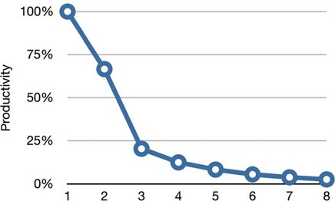
Productivity by release
∟
When little or no thought is given to the cleanliness of the code or the structure of the design, as the project grows and complexity increases, the effort for any given new feature, increases as well.
∟
Notes:
Diagrams from Clean Architecture
Case study

Slide 12
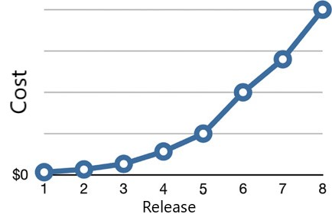
Cost by release
∟
What caused this remarkable change in productivity? Why was the code 40 times more expensive to produce in release 8 as opposed to release 1?
∟
Notes:
Diagrams from Clean Architecture

Slide 13
02
Some Theory

Slide 14

Clean Architecture
Hexagonal Architecture
Onion Architecture
Ports & Adapters
SOLID
Notes:
Ask the audience – show of hands

Slide 15
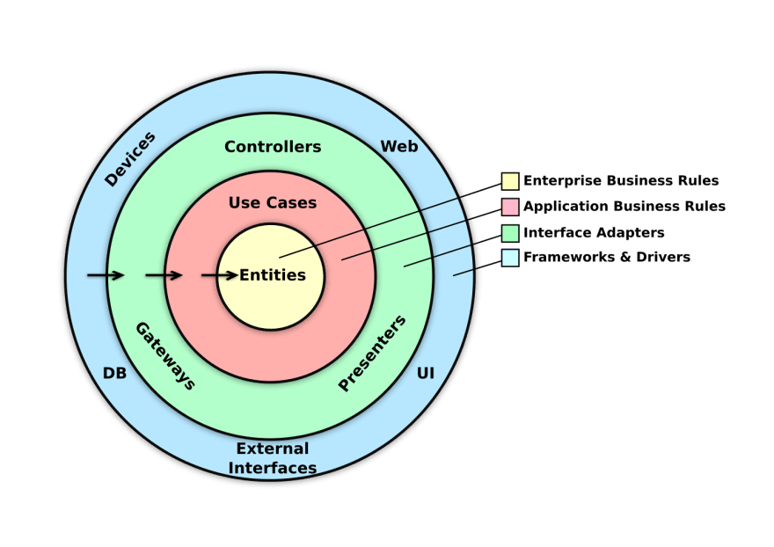
Clean Architecture
Notes:
Describe briefly what we see
Connect with the Application slide

Slide 16
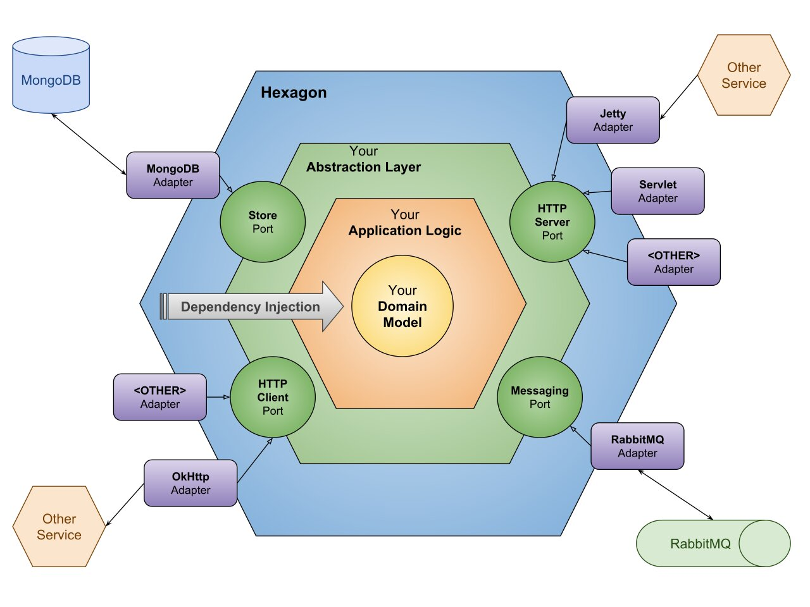
Hexagonal Architecture

Slide 17
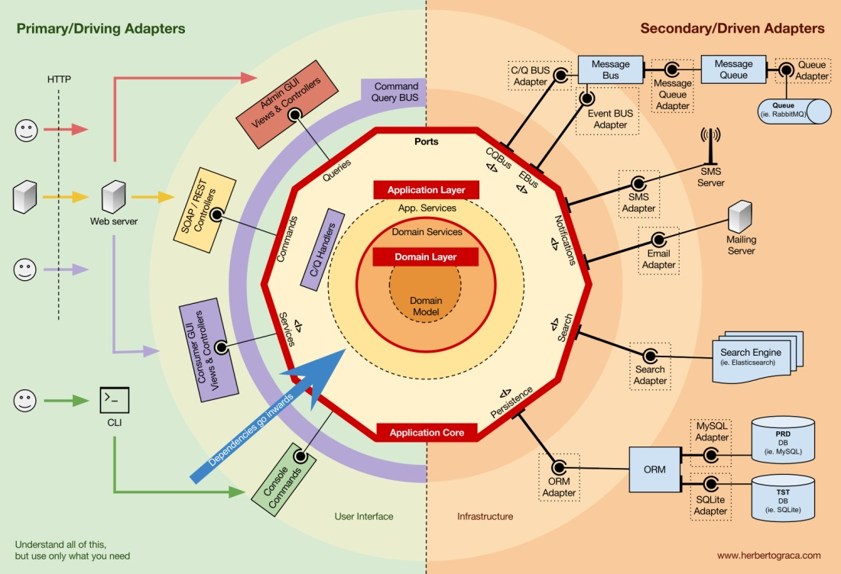
Ports & Adapters
Notes:
Reasons I like this diagram
Show the commonalities between all diagrams

Slide 18
SOLID
Single Responsibility Principal (SRP)
Group things, that change together
Open Closed Principal (OCP)
The code should be open for extension and closed for modification
Liskov’s Substitution Principal (LSP)
Derived classes should extend their base classes without changing their behavior
Interface Segregation Principal (ISP)
Just expose only the things that are needed to the consumer
Dependency Inversion Principal (DIP)
The flow of control is opposite to the flow of execution

Slide 19
03
Into the Code

Slide 20
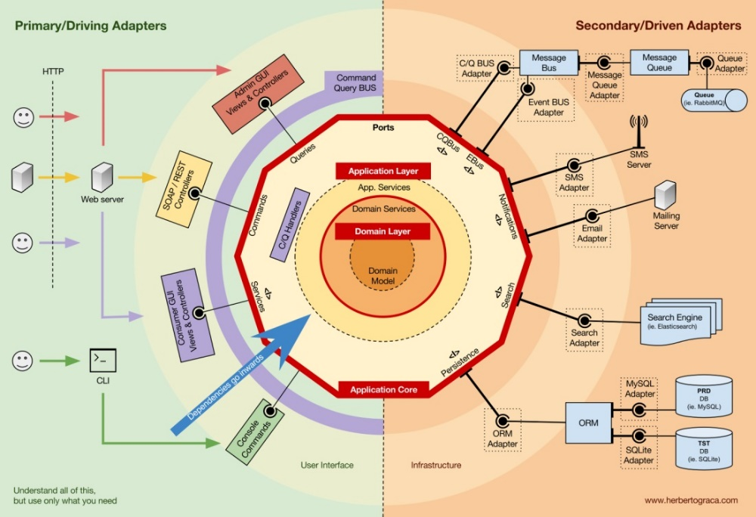
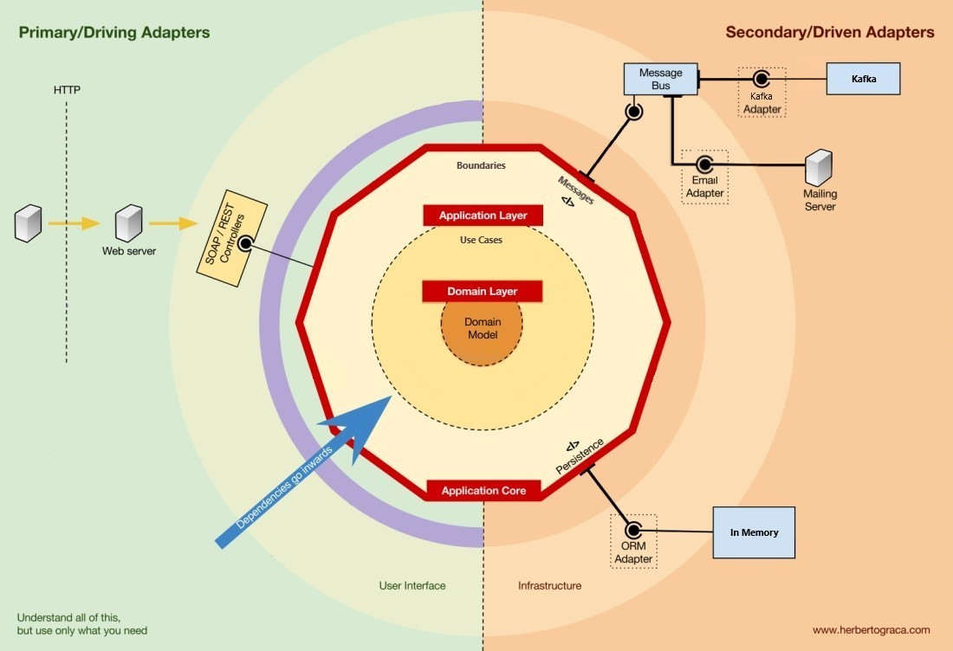

Slide 21
04
Takeaways

Slide 22
Quote
“A good software architecture allows major decisions to be differed.
A good Architect maximizes the number of decisions not made.”
Uncle Bob

Slide 23
Conclusion
Work with domain experts
Define the domain entities
Develop and common understanding
Develop a common language to communicate
Analyze dependencies and recognize boundaries
The core of the application should be protected from changes in the environment
Ideally the core layer should have zero dependencies
Differ important decisions
Heavily Unit test the core of the application
Don’t over-engineer

Slide 24
The most important thing in software development is Communication.

Slide 25


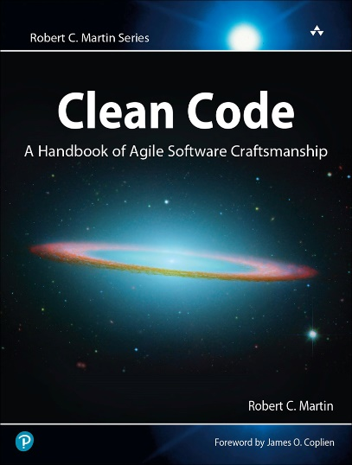

References
Notes:
Stay here for a few seconds

Slide 26

Evangelos Barmpas evangelos.barmpas@lhsystems.com
https://github.com/vag1830
Notes:
The code and the presentation are on my github

Slide 27
Questions
?

